Slide 1
Gender and Climate Change
Naperville AAUW - April 9, 2019
Dr. Erin C. Bergren

Slide 2
Outline of the presentation
How is climate change a social phenomenon?
Are women and men affected by climate change in the same way?
Are there gender differences in responsibilities for climate change?
How does gender inequality affect adaptation to climate change?
How does gender alter responses to climate change?

Slide 3
Climate change as a social phenomenon

Slide 4
Climate change is social
Climate change is contingent upon social choices
Thinking of climate change as a physical phenomenon obscures these social choices
How much greenhouse gas is emitted into the atmosphere
How we respond to climate change
Who is most (and least) affected by climate change

Slide 5
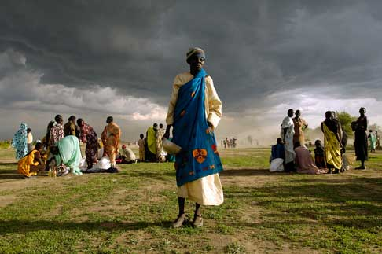
What is vulnerability?
Vulnerability is the risk of being harmed as a result of a particular hazard
When we talk about climate change risk, scholars will refer to differential vulnerability
Vulnerability to climate change varies along lines of social difference – race, class, ability, age, and gender to name a few
This is because your social status is, generally speaking, a determinant of whether you are exposed to hazard, and whether you are harmed by that exposure

Slide 6
Differential vulnerability
Stockbroker
Secure two-income family
Savings to deal with disasters
Strong connections to power brokers and decision makers
Nurse
Single income household
Some insurance
Strong network of friends and family
Fast food worker
Single income household
No insurance or savings
Limited access to decision makers
Language barriers
Renter
A climate-related disaster will affect these women unequally

Slide 7
Vulnerability varies by location
Dangerous climate change affects people in the Global South more severely than it affects people in wealthy nations
People in the Global South have fewer resources to deal with climate impacts
Disasters are deadlier in the Global South
Conflict is more likely in the Global South

Slide 8
Are men and women affected equally?

Slide 9
Gender inequalities amplify vulnerability
People who are already marginalized are more vulnerable to the negative effects of climate change
Gender inequality is a form of marginalization
Fatma Denton describes gender inequality as a ‘layer’ of differentiated vulnerability to climate change

Slide 10
Why are women affected differently?
On the household level, women are often left out of decision-making and given fewer resources than men
Women have disproportionate burden for caregiving of vulnerable family members
Men and women express different preferences as to how household resources should be used to prepare for environmental hazards
Women have less access to education and decision-making
Women suffer higher rates of gender-based violence and are more severely affected by civil conflict
Gendered inequalities in institutions create barriers to adaptation

Slide 11
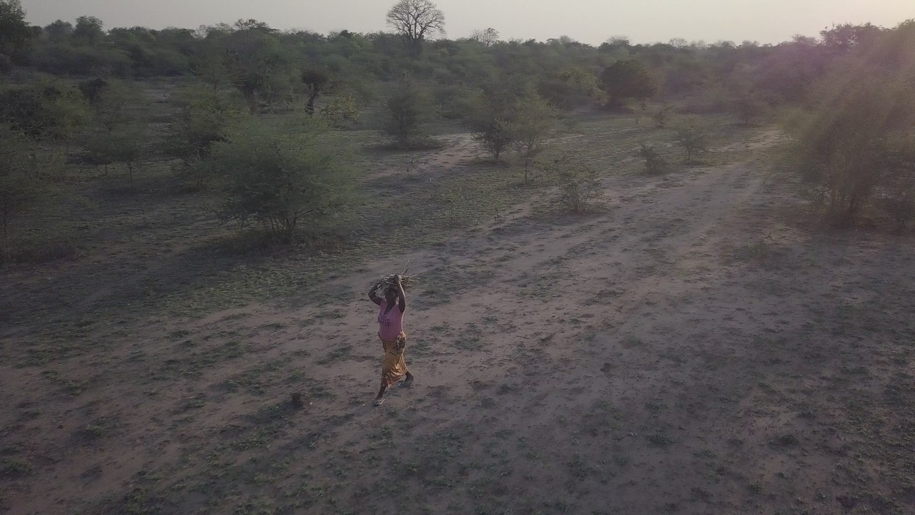
Case study: Kakota et al 2015
Household survey in Malawi
Women’s work includes collecting water and firewood.
Climate change is increasing water scarcity and reducing forest cover, forcing women to travel farther to acquire water and fuelwood
This increases women’s labor time and physical effort and also exposes them to gender based violence

Slide 12
Women are disproportionately affected by disasters
Women are more likely to be poor and have poor nutrition, have greater domestic responsibilities, and are less able to stockpile resources or disaster-proof their housing
Women in disasters face higher rates of mortality
Women face gender-based violence in the aftermath of disasters
Women are poorly represented in post-disaster decision-making, with less access to post-disaster recovery resources

Slide 14
Women’s vulnerability is intersectional
Gender is only one axis of social difference which affects differential vulnerability and marginalization
Gender inequality is a social process which intersects with a number of different types of power imbalances
For example, being a woman is only one of many reasons why a person might not get access to post-disaster aid.
Other reasons include race, caste/class, language barriers, disability, age, sexual orientation, etc
Women’s vulnerability is part of a network of hierarchies of power

Slide 15
Gendered responsibility

Slide 16
Is gender a part of overconsumption?
Patterns of energy consumption are gendered, with men tending to make more energy intensive choices
Commute longer distances
Purchase less efficient vehicles
Overall involvement with work related to energy consumption
Men tend to have higher incomes, which is a precursor of consumption
Overconsumption is “masculinized” (Alaimo 2009)
Per capita emissions are lower in states where women have higher political status (Ergas and York 2012)

Slide 17
Gender and climate change adaptation

Slide 18
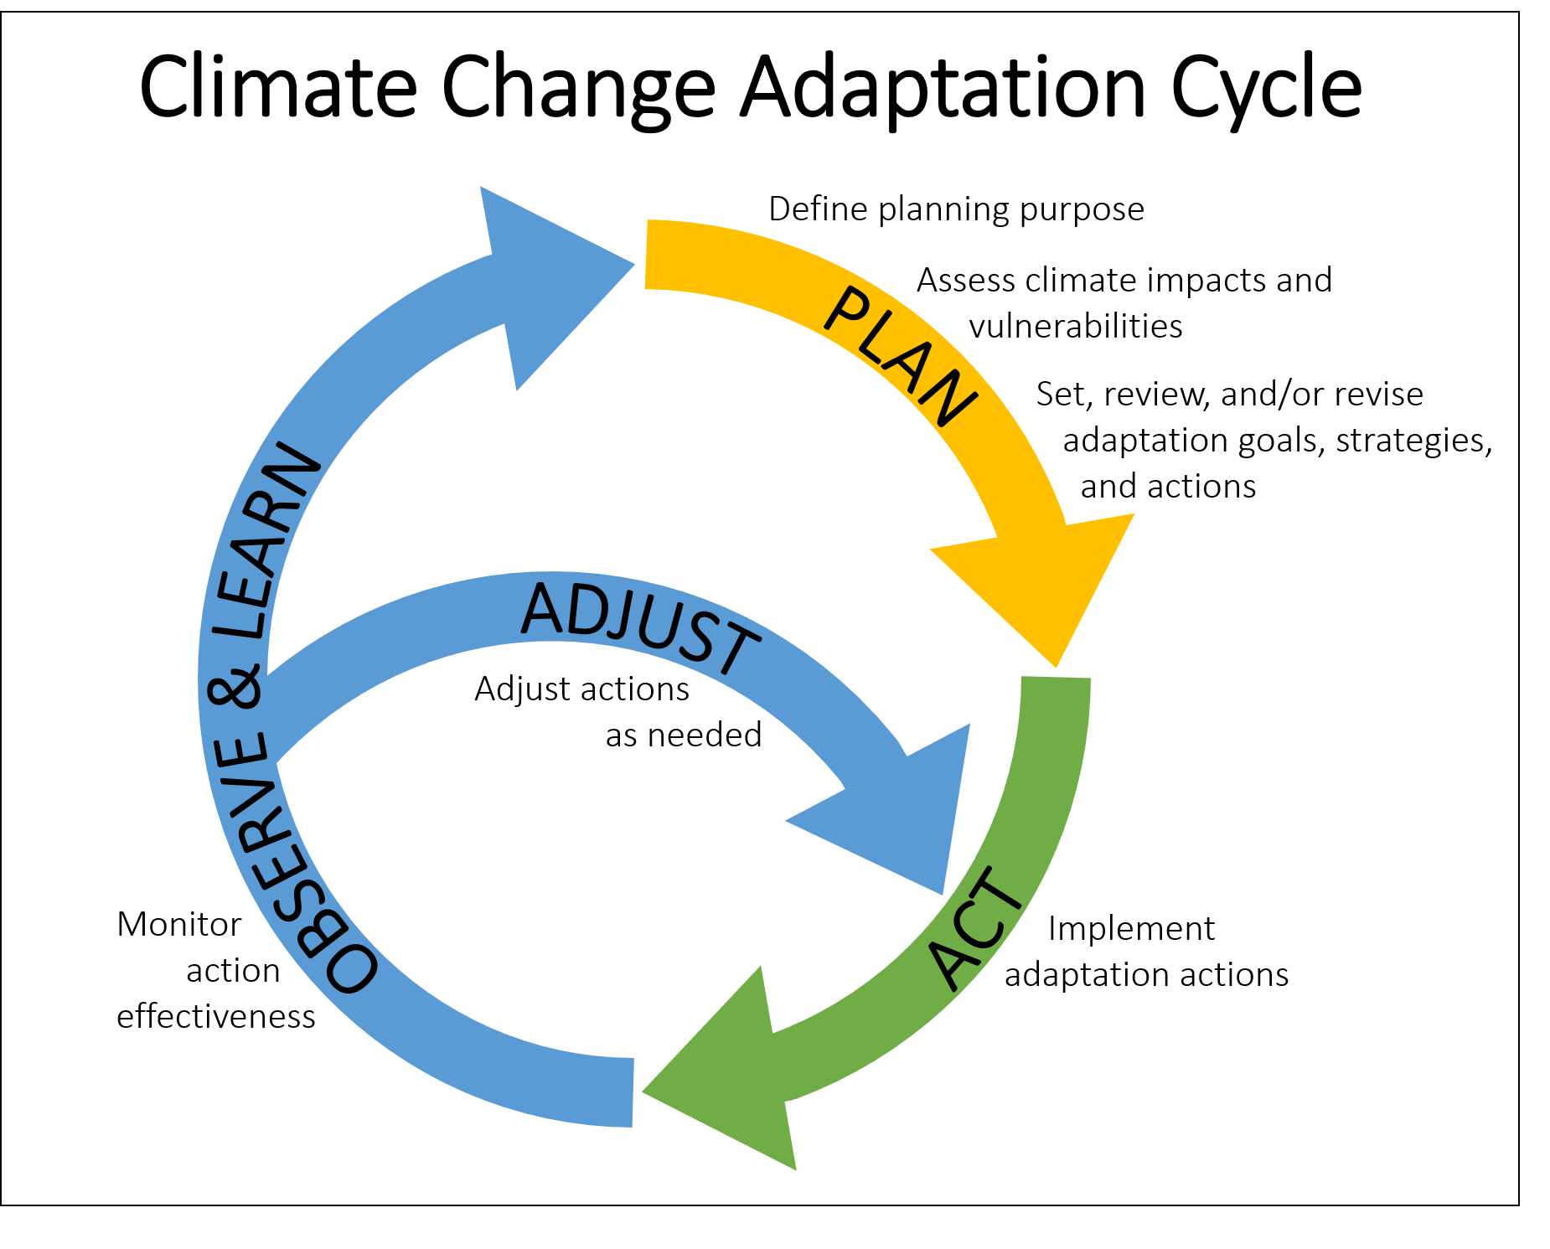
What is adaptation to climate change?
Adaptive actions are those taken to reduce the severity and impact of negative climate related hazards
E.g. Seawalls and levees
E.g. Community emergency response training (CERT) classes

Slide 19
Women’s responses to climate change
The adaptation actions undertaken by men and women are contextual, but do tend to vary because of the different social status associated with gender
Gender inequalities persist and may even become worse in a changing climate
Women’s knowledge is often vital climate information
Because women are often primary resource producers, they have often gathered important environmental knowledge which gives us knowledge of a changing climate
Climate change can also open up new policy windows, offering new opportunities to contest and challenge gender inequalities

Slide 20
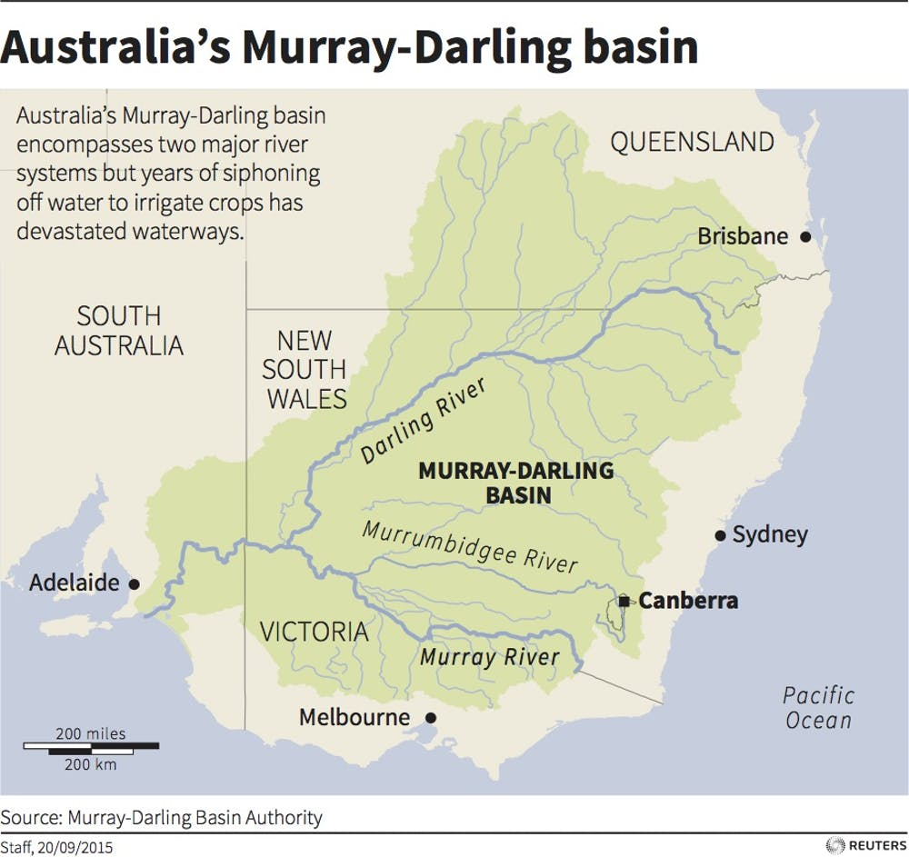
Case study: Alston 2011
Study of drought in rural communities in the Murray-Darling Basin in Australia
Rural men tend to bear the burden of increasingly fraught on-farm work, leading to social isolation and other negative effects.
Rural women tend to take on increased work outside the home, increasing both stress and autonomy.
Disruption of gender inequalities can cause men to experience “crises of masculinity” as environmental hardship undermines their ability to be breadwinners

Slide 21
Gender and responses to climate change

Slide 22
Women are more likely to be concerned about climate change
Women report higher levels of concern about climate change
Women are more likely to perceive shifts in climate
Women in the United States and Iran have more understanding of the science behind climate change and are also more likely to underestimate their scientific knowledge
Conservative, older, white males report the least concern about climate change
Scholars McCright and Dunlap ascribe this to the fact that conservative, white, older males are in positions of power that are threatened by the action needed to combat climate change

Slide 23
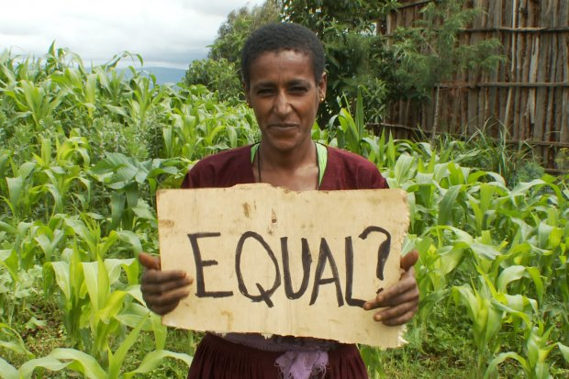
Women are under-represented in climate change decisions
Women are under-represented in, for example, the United Nations Framework Convention on Climate Change (UNFCCC) negotiations
This includes the Kyoto Protocol and the Paris Agreement
Women are ‘minimally’ present on the boards of major energy companies
Women are under-represented in post-disaster decision making

Slide 24
Climate mitigation and adaptation can reinforce gender norms
Unless social inequality is an explicitly addressed concern, many responses to climate change risk reinforcing existing social inequalities and hierarchies of power
For example, a study of a reforestation project in Bolivia (Boyd 2002) found that wage work was offered to men, not women
Reinforced existing gender dynamics regarding household roles
Prioritize men’s needs over women
Some scholars argue that development itself reinforces gender inequalities, an observation which exists in multiple studies (Bhattarai et al 2015)

Slide 25
Women have agency
Some scholars worry that there is too much emphasis on women’s vulnerability and virtuousness, obscuring the very real ways in which women are agents of their own destiny (see, for example, Djouda et al 2016)
Stacey Alaimo proposes a stance called “insurgent vulnerability” wherein our own connection to the material and environmental world compels a certain set of ethical responses to climate change
Insurgent vulnerability recognizes the way in which gendered inequalities are intersectional and connected to larger social ills such as colonialism

Slide 26
Recap
Climate change is a social process that affects men and women unequally due to social hierarchies of power that manifest in gender inequalities
Women, who are already marginalized in most societies, are disproportionately harmed by environmental hazards including climate change
Women may bear less responsibility for greenhouse gas emissions
Women are less able to adapt to climate change and are under-represented in decision making around climate change
Women’s vulnerability is intersectional; responses to climate change can reinforce existing gender inequalities or disrupt them

Slide 27
References
Alaimo, Stacey (2009). Insurgent Vulnerability and the Carbon Footprint of Gender. Kvinder, Køn, and Forskning 3-4
Alston, M. (2011). Gender and Climate Change in Australia. Journal of Sociology 47(1):53-70
Arora-Jonsson, S. (2011). Virtue and vulnerability: Discourses on women, gender and climate change. Global Environmental Change, 21(2), 744-751.
Bhattarai, B., Beilin, R., & Ford, R. (2015). Gender, agrobiodiversity, and climate change: A study of adaptation practices in the Nepal Himalayas. World Development, 70, 122-132.
Boyd, E. (2002). The Noel Kempff project in Bolivia: gender, power, and decision-making in climate mitigation. Gender & Development, 10(2), 70-77.
Djoudi, H., Locatelli, B., Vaast, C., Asher, K., Brockhaus, M., & Sijapati, B. B. (2016). Beyond dichotomies: Gender and intersecting inequalities in climate change studies. Ambio, 45(3), 248-262.
Ergas, C., & York, R. (2012). Women’s status and carbon dioxide emissions: A quantitative cross-national analysis. Social Science Research, 41(4), 965-976.
Harris, Rachel (2012) Women Making the Case for U.S. Action on Climate Change. Women’s Environment and Development Organization (WEDO).
Hemmati, M. (2000). Gender-specific patterns of poverty and (over-) consumption in developing and developed countries. In Society, behaviour, and climate change mitigation (pp. 169-189). Springer, Dordrecht.
Kakota, T., Nyariki, D., Mkwambisi, D., & Kogi‐Makau, W. (2015). Determinants of Household Vulnerability to Food Insecurity: A Case Study of Semi‐Arid Districts in Malawi. Journal of international development, 27(1), 73-84.
Juran, L., & Trivedi, J. (2015). Women, gender norms, and natural disasters in Bangladesh. Geographical Review, 105(4), 601.
McCright, A. M. (2010). The effects of gender on climate change knowledge and concern in the American public. Population and Environment, 32(1), 66-87.
McCright, A. M., & Dunlap, R. E. (2013). Bringing ideology in: the conservative white male effect on worry about environmental problems in the USA. Journal of Risk Research, 16(2), 211-226.
Mersha, A. A., & Van Laerhoven, F. (2016). A gender approach to understanding the differentiated impact of barriers to adaptation: responses to climate change in rural Ethiopia. Regional Environmental Change, 16(6), 1701-1713.
Pearse, R. (2017). Gender and climate change. Wiley Interdisciplinary Reviews: Climate Change, 8(2), e451.
Salehi, S., Nejad, Z. P., Mahmoudi, H., & Knierim, A. (2015, May). Gender, responsible citizenship and global climate change. In Women's Studies International Forum (Vol. 50, pp. 30-36). Pergamon.

